Slide 1

Haptic Gaming Assistant using AI
Presented by: B22
Aditya Bhonsle - 174201
Bhagan Ram - 174206
Kancharla Sai Kowshik - 174218
Under the guidance of:
Dr. K. L. V. Sai Prakash Sakuru
Associate Professor
Electronics and Communication Engineering

Slide 2
Problem Statement
Next-generation gaming experience has been revolutionized with VR/AR. This has lead to development of controllers and is active area of research. New users need assistance while playing with these controllers for first time.
Use Open-Source model of Haptic Feedback Exoskeleton Hand
Create Simulation Environment for Training and Testing using Unity/Python
Use AI to control movement of assistant while taking input from Simulation Environment

Slide 3
Specifications
Hardware
Software
3D Printing Model (15x15cm)
Filament material: ABS
Resolution:0.2mm
Infill %: 50
Quality: Standard
Arduino Mega 2560
Bi-directional DC Motors:
Voltage:6V, RPM:30
Flex Sensors
Nuts & Bolts
M6 x 18mm
M9 x 50mm
M6 x 12mm
Unity(ver: 2020.1)
ml-agents(ver: 1.0)
TensorFlow(ver: 2.7.2)
Arduino IDE(ver: 1.8)
Python(ver: 3.6)
C#
.Net Framework(ver: 4)
Notes:
Project description
List of all the pages/screens with all the features
User path
Design mockups or wireframes
Tech stack related info

Slide 4
Applications
Guides player to play correctly
Saves time and extra effort.
Can Gamification of Prosthetic Rehabitilation
Extending the idea by using a complete exoskeleton, we can make trainers for:
martial arts, dancing, playing instrument, VR gaming, etc.

Slide 5
Advantages
Using 3D-printed model which can directly interact with hand and improves overall experience.
This design makes the controller more human friendly and interactive.
Limitations
Can't play complex games:
Feasibe AI models can play simple games
Current model has Single DOF for each finger

Slide 6
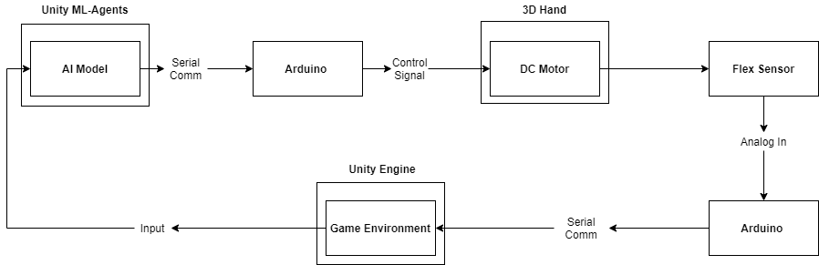
Introduction
We are integrating two independent ideas:
Guesture Controlled 3D Printed Exoskeleton Hand
AI playing Game
We wish to develop assistant that will help new player play the game by moving the required fingers needed using the AI's help.

Slide 7
Haptic Technology - 3D Printing
Haptic feedback using exoskeleton which provides extended experience as body part is guided by its force.
Adds new layer and freedom for user as compared to traditional controllers.
We are using model which uses 3D-printing to create sub-parts and is powered by Arduino and stepper motors
Model has 1 DoF for each Fingers.

Slide 8
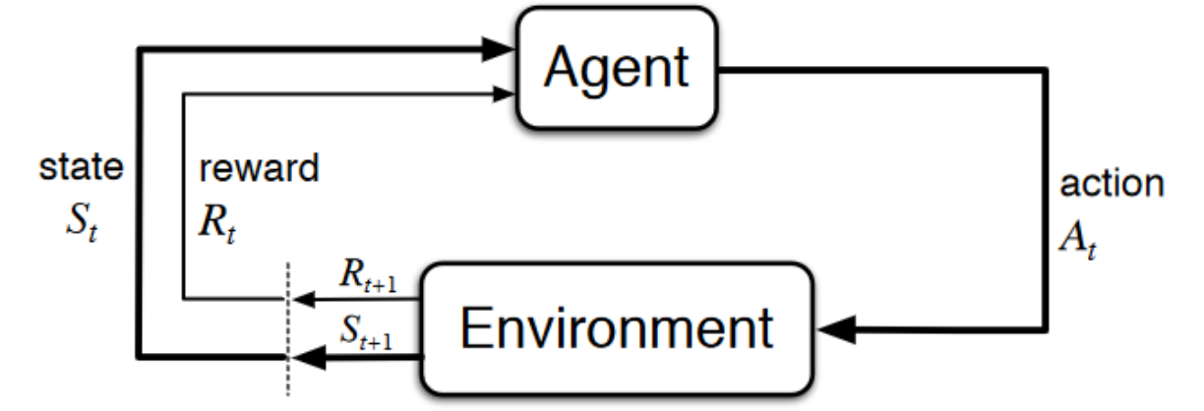
AI Playing games
RL creates network which accumualtes predefined rewards for actions in environment.
Some acitions are rewarded positively while others negatively.
Network learns favourable actions by maximizing the accumulated rewards.

Slide 9
Unity for training agents
Create Gaming Environment with same functionality for training and testing agents.
Using Reinforcement Learning algorithms with ml-agents package to train Neural Network.
Trained Neural Network can be used to control Robotic parts.
Saves effort of training the robotics manually.

Slide 10
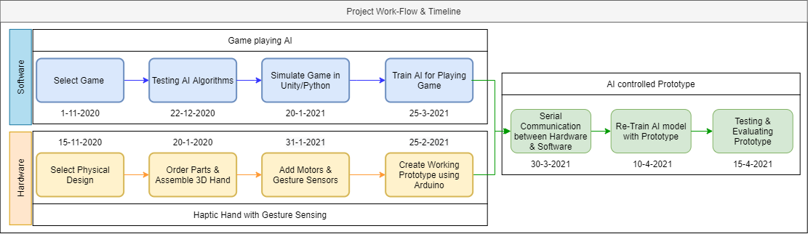
Project Work-Flow

Slide 11
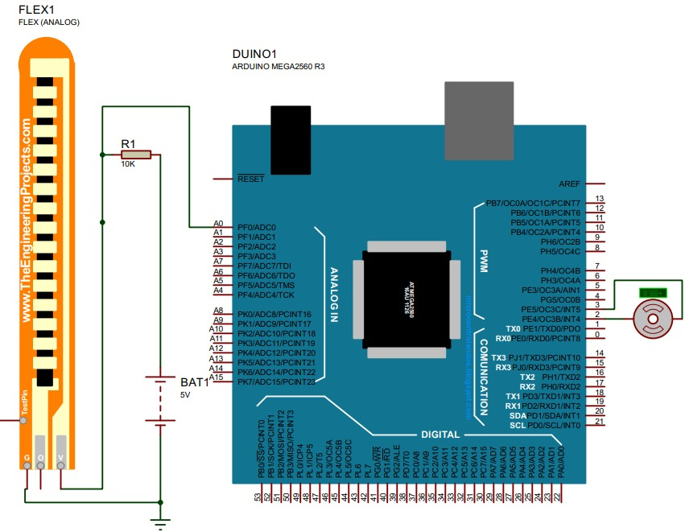
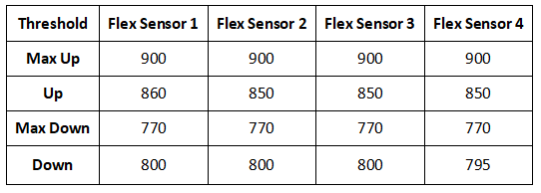
Work Done: Hardware
Proposed Circuit for Implementation
Defined Limits for Flex Sensors

Slide 12
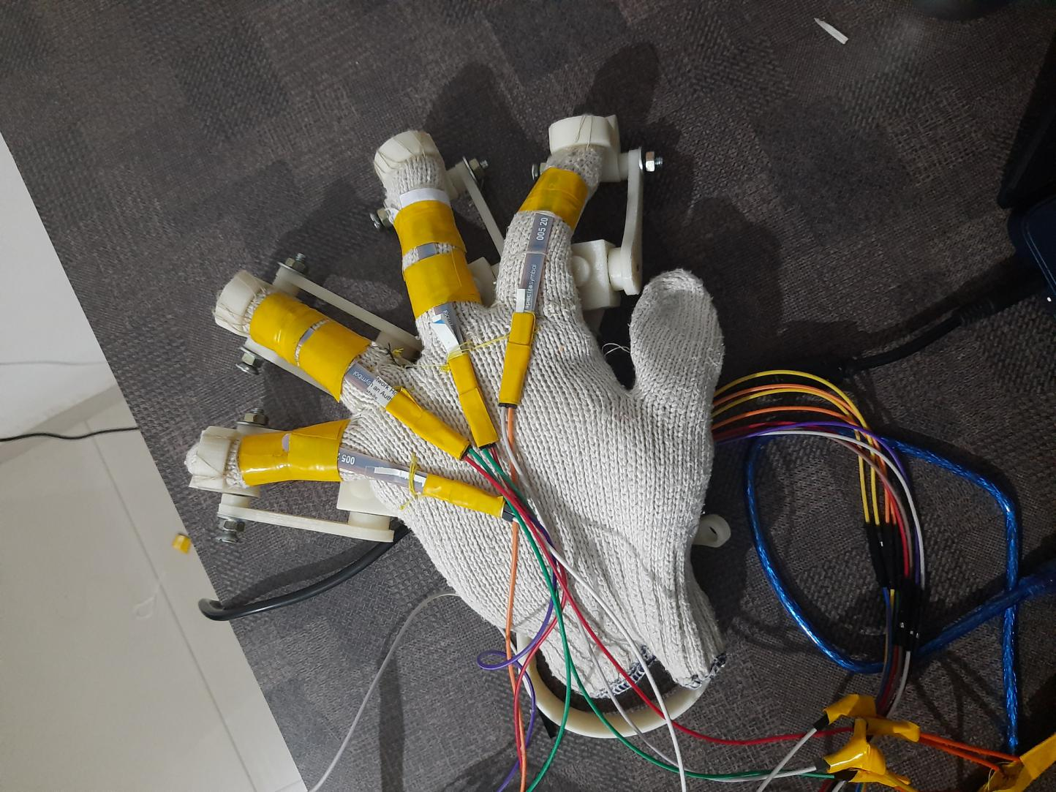
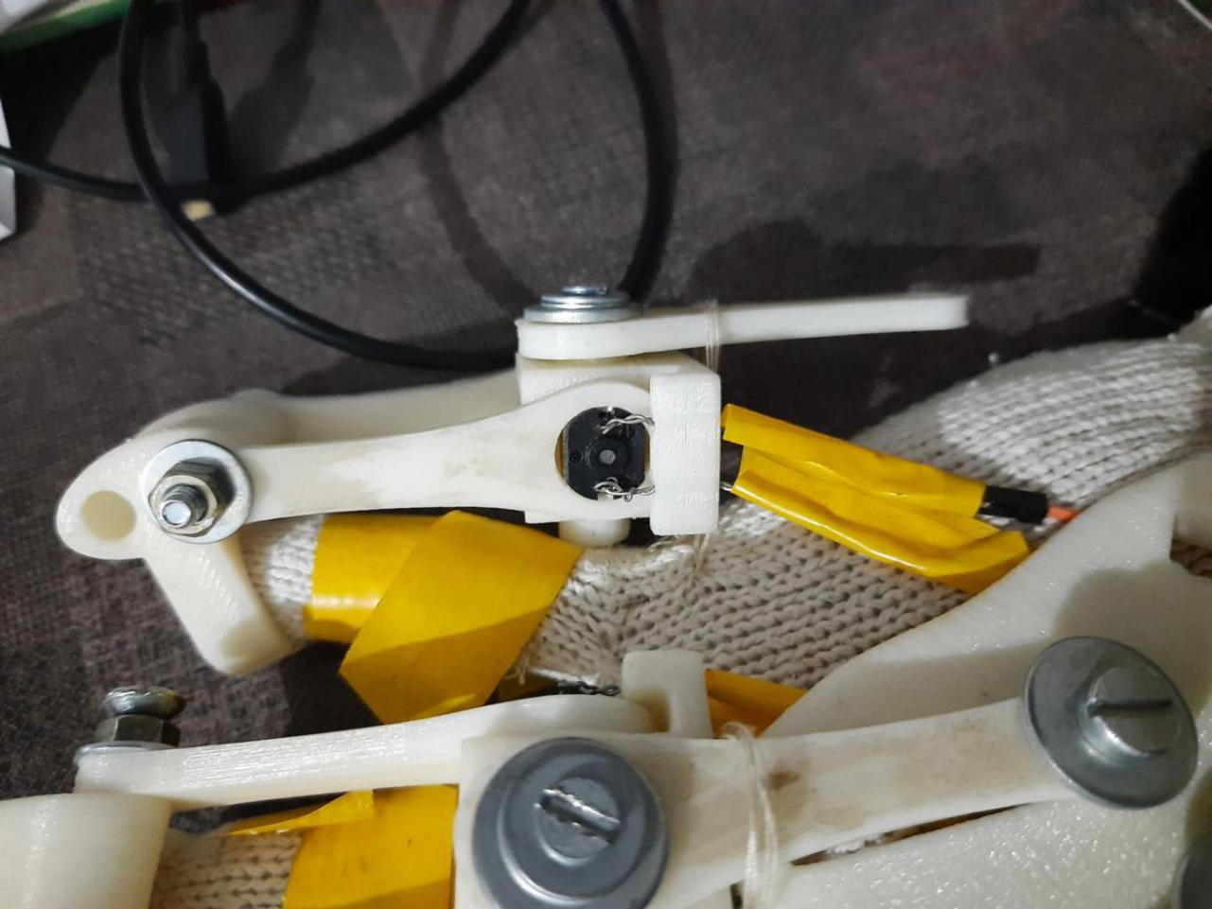
Work Done: Hardware
Recreated Mechanical Hardware for Assistant
Installed DC Motors and Flex Sensors on Assistant
Created Working Prototype using Arduino
DC Motor Fitting and Wiring Side View
Flex Sensors on Assistant

Slide 13
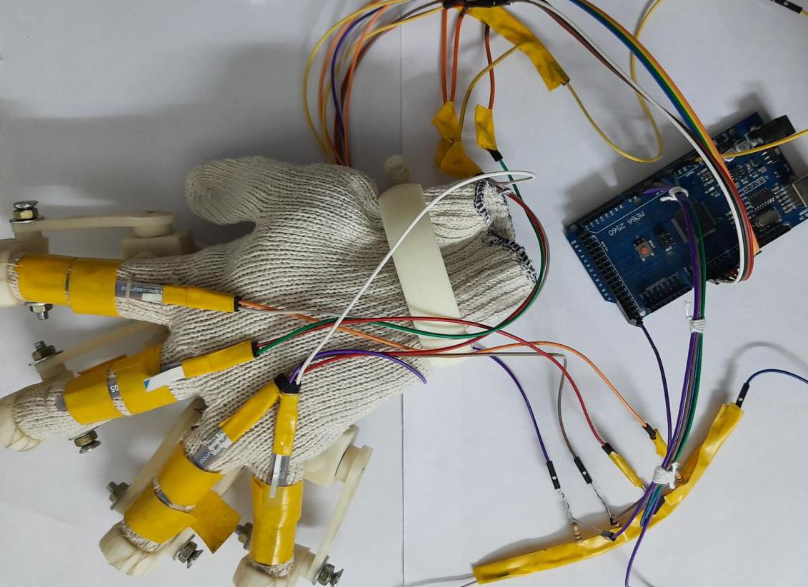
Work Done: Hardware
Completly Assembled Assistant

Slide 14
Work Done: Software
Explored various AI alogorithms
Genetic Algorithm: NEAT
Reinforcement Learning: DQN
Hand Guesture Recognition: 2DConv-NN
Simulated Unity Environments
3D Ball, Jumping Cars Game
Created Arduino program for Working Prototype
Trainied AI models for Unity Environments
Implemented Serial Communication between Arduino and Unity
Implemented AI controlled Assistant using Feedback Control

Slide 15
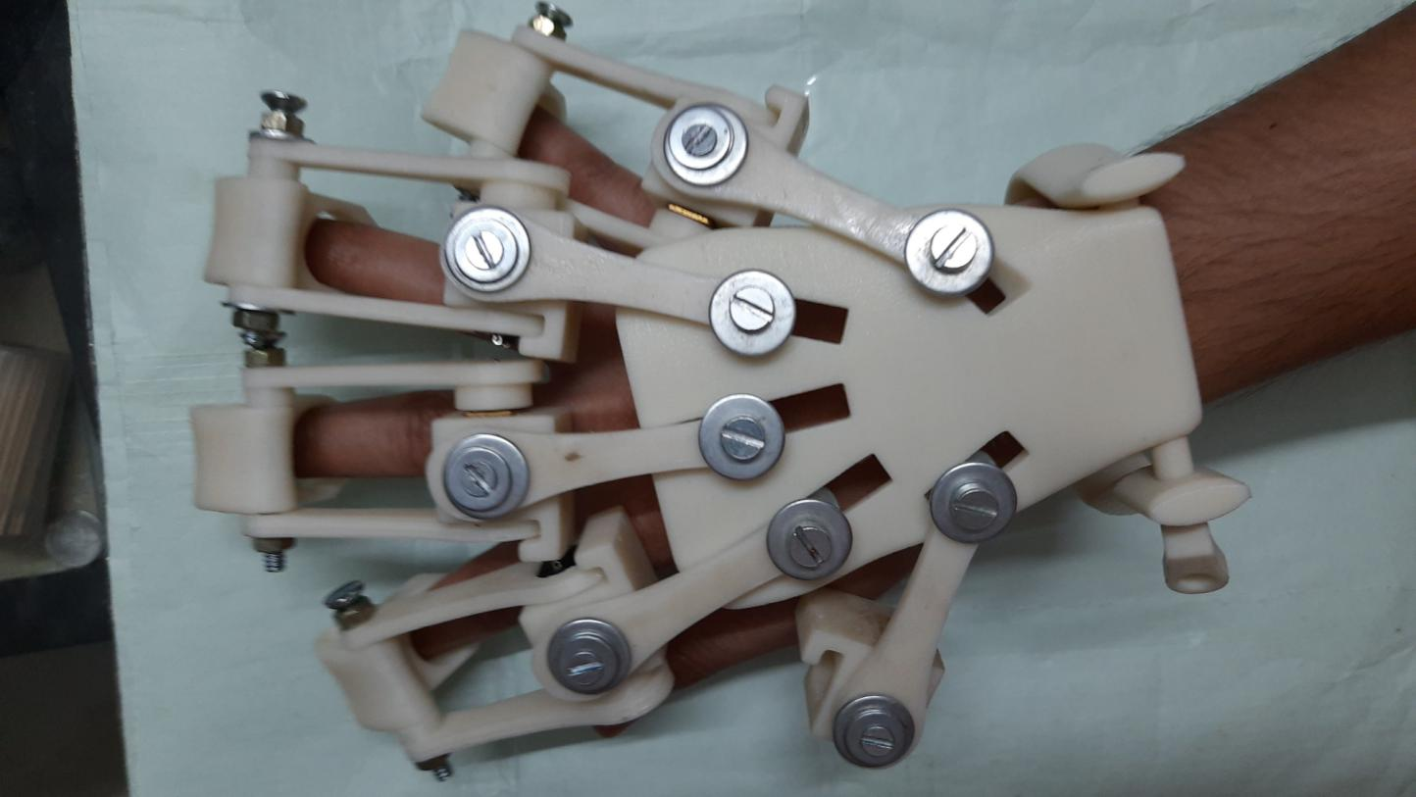
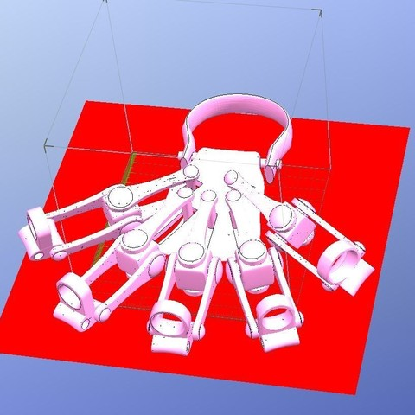
Results: Hardware Implemetation
Recreating Mechanical Parts for Hardware
Copyright (c) Alex Czech 2015
Czech, A., 2015. 3D PRINTED EXOSKELETON HANDS - IN ONE PIECE. [image] Available at: <https://files.cults3d.com/uploaders/3695667/illustration-file/1435670806-19154-8542/Exo-Hand_Left_One_Piece_ISO_View_large.JPG> [Accessed 25 November 2020].
Top View of Assembled Parts

Slide 16
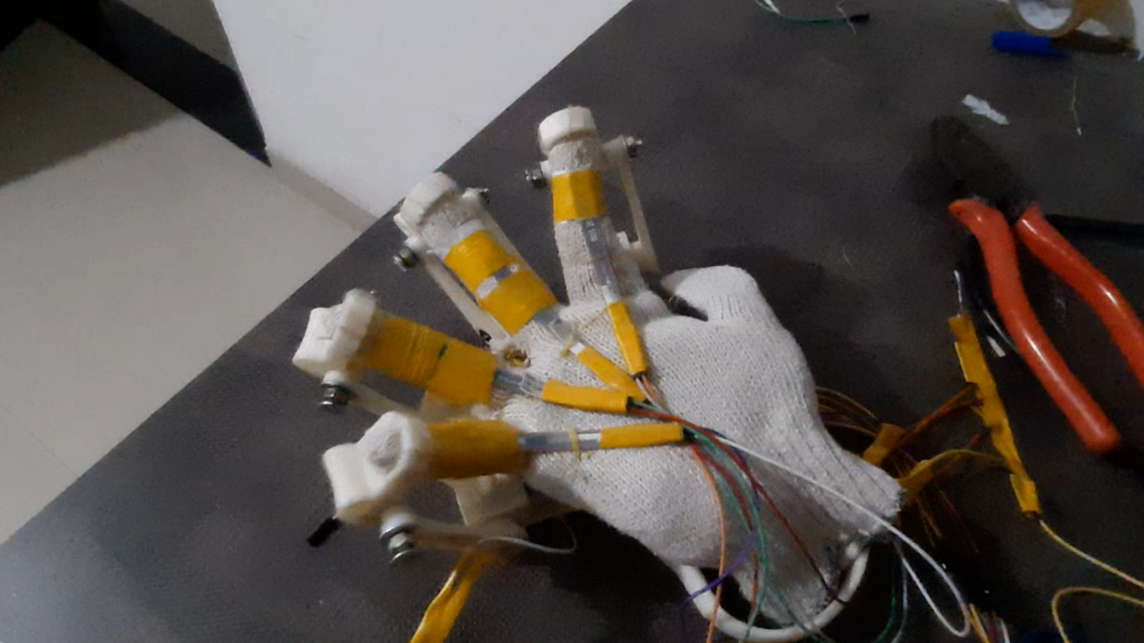
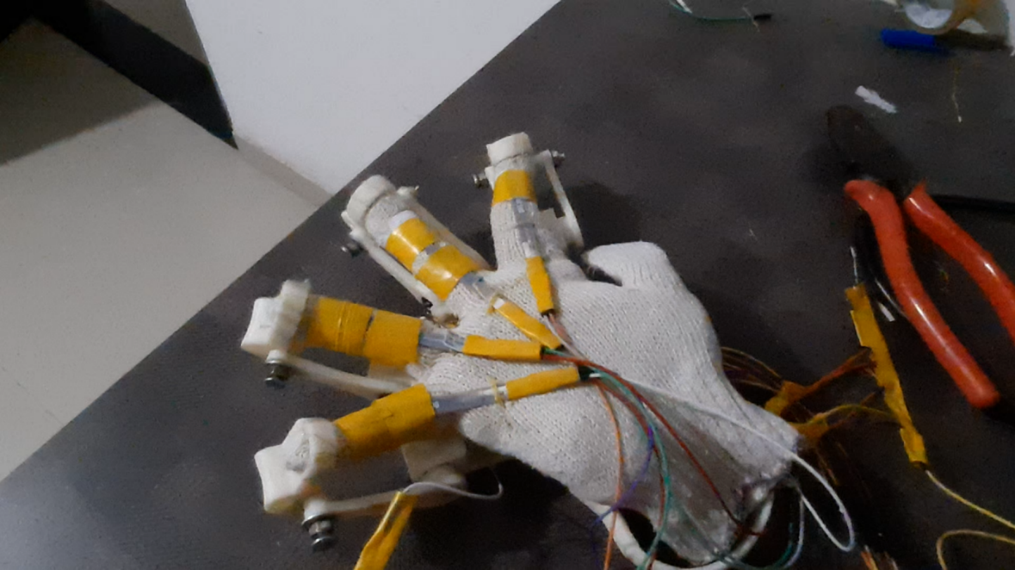
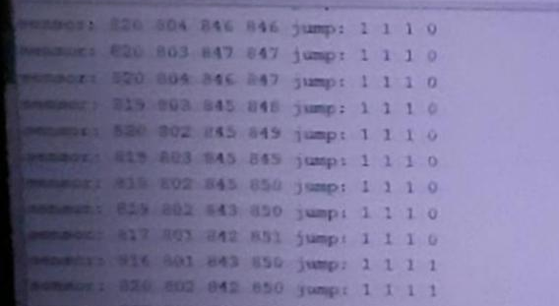
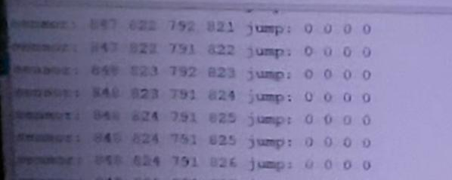
Results: Working Prototype
Arduino Executing Down
Arduino Executing Up

Slide 17
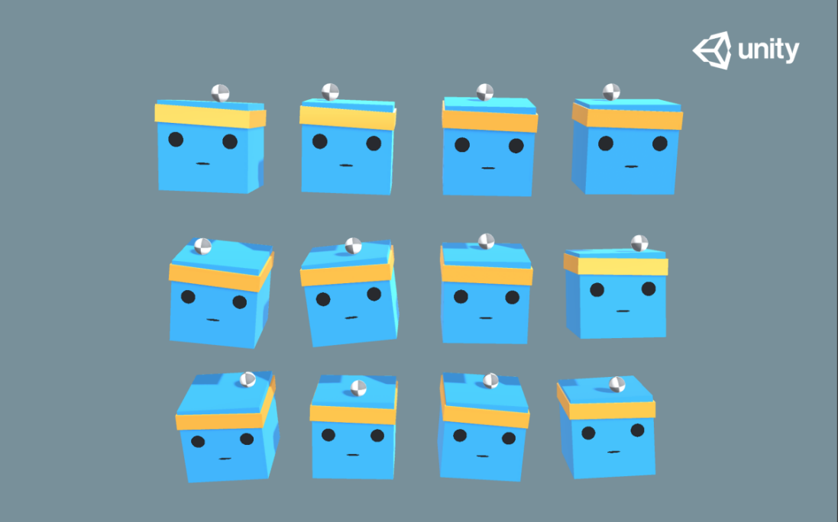
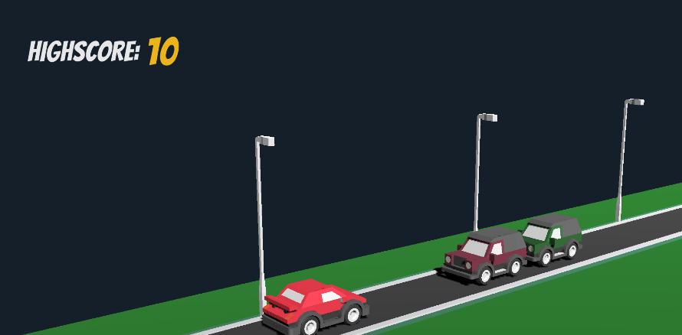
Results: Simulations
Simulated Environments in Unity
3D Ball Environment
Jumping Car^{[15]} Enviroment
Jumping Car Still^{[15]}
3D Ball Game Still^{[10]}

Slide 18
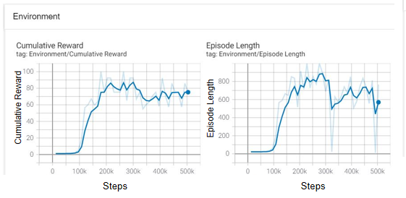
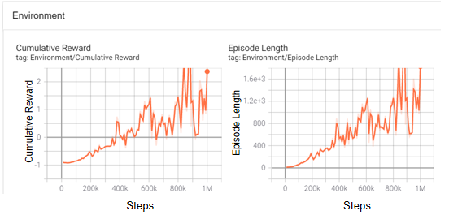
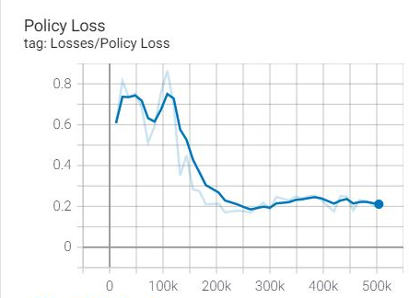
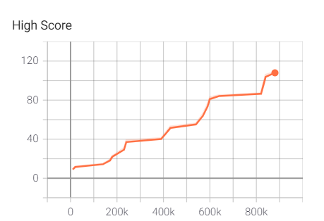
Results: Metrics of AI Models
3D Ball Environement
Jumping Car Environment
Policy Loss
High Score
Steps
Steps

Slide 19
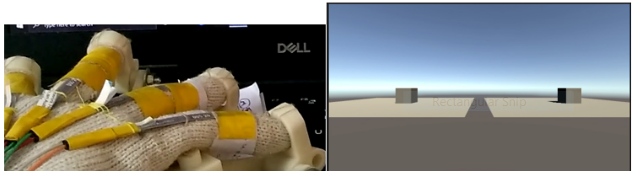
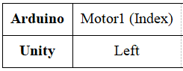
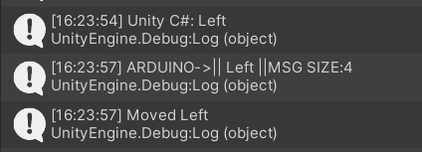
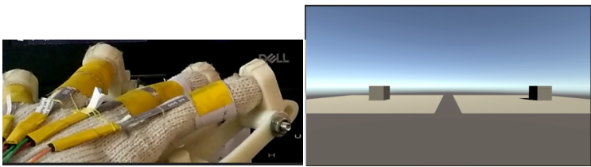
Results: Serial Communication
Unity Arduino Lookup Table for Left
Before ‘Left’ Command Execution
Unity Serial Log
After ‘Left’ Command Execution

Slide 20
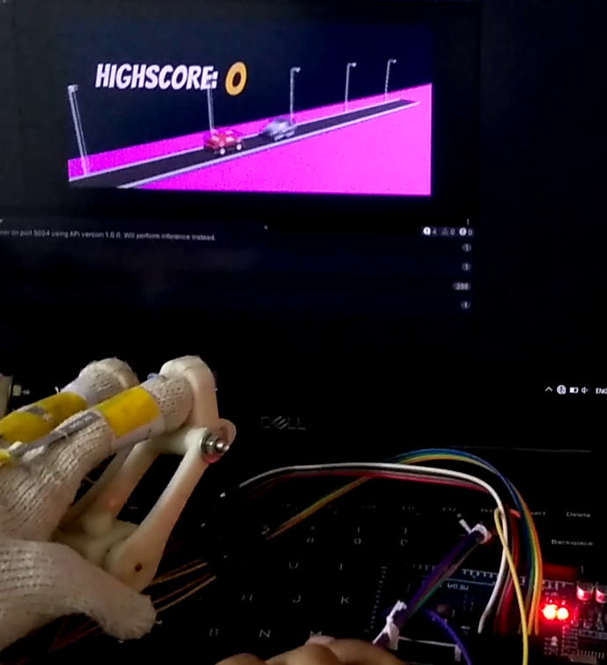
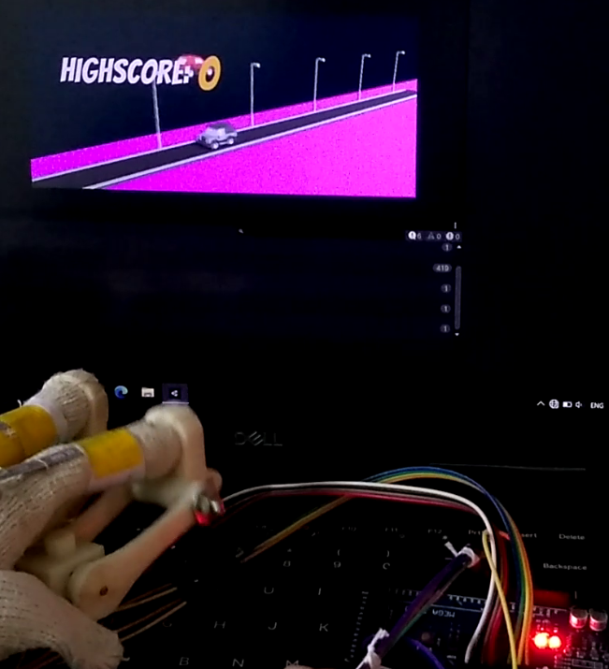
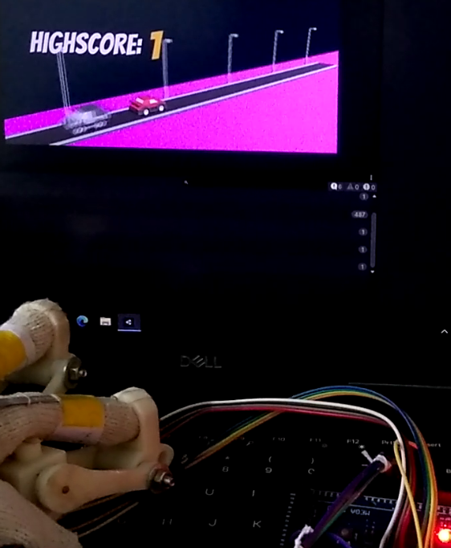
Results: Final Game Implementation
AI Sensing Obstacle & Arduino Executing Command
Arduino Unity Communication & Update in Unity Environment
Obstacle Successfully Escaped and Score Increased

Slide 21
Reference List
[1]Czech, A., 2015. 3D PRINTED EXOSKELETON HANDS - IN ONE PIECE. [image] Available at: https://files.cults3d.com/uploaders/3695667/illustration-file/1435670806-19154-8542/Exo-Hand_Left_One_Piece_ISO_View_large.JPG> [Accessed 25 November 2020].
[2]A. Imran, “Training a Robotic Arm to do Human-Like Tasks using RL,” Data Driven Investor, 28-Feb-2019. [Online]. Available: https://medium.com/dastadriveninvestor/training-a-robotic-arm-to-do-human-like-tasks-using-rl-8d3106c87aaf. [Accessed: 25-Nov-2020].
[3]Perret, Jérôme & Vander Poorten, Emmanuel. (2018). Touching Virtual Reality: a Review of Haptic Gloves.
[4]D. Marwah, S. Srivastava, A. Gupta, and S. Verma, “Chrome Dino Run using Reinforcement Learning,” arXiv [cs.AI], 2020.
[5]Wikipedia contributors, “Q-learning,” Wikipedia, The Free Encyclopedia, 20-Oct-2020. [Online]. Available: https://en.wikipedia.org/w/index.php?title=Q-learning&oldid=984486286. [Accessed: 25-Nov-2020].
[6]A. Juliani et al., “Unity: A general platform for intelligent agents,” arXiv [cs.LG], 2018.
[7]"An introduction to Q-Learning: reinforcement learning", freeCodeCamp.org, 2018. [Online]. Available: https://www.freecodecamp.org/news/an-introduction-to-q-learning-reinforcement-learning-14ac0b4493cc/. [Accessed: 25- Nov- 2020].
[8]"Understanding the Role of AI in Gaming", AiThority, 2020. [Online]. Available: https://aithority.com/computer-games/understanding-the-role-of-ai-in-gaming/. [Accessed: 25- Nov- 2020].
[9]"What Is AI in Gaming? – Arm", Arm.com, 2020. [Online]. Available: https://www.arm.com/glossary/ai-in-gaming. [Accessed: 25- Nov- 2020].’

Slide 22
References
[10]"Unity-Technologies/ml-agents", GitHub, 2021. [Online]. Available: https://github.com/Unity-Technologies/ml-agents/blob/0.15.1/docs/Getting-Started-with-Balance-Ball.md. [Accessed: 31- Mar- 2021].
[11]“techwithtim/NEAT-Flappy-Bird", GitHub, 2021. [Online]. Available: https://github.com/techwithtim/NEAT-Flappy-Bird. [Accessed: 31- Mar- 2021].
[12]Orozco, Mauricio & Silva, Juan & El Saddik, Abdulmotaleb & Petriu, Emil. (2012). The Role of Haptics in Games. 10.5772/32809.
[13]Ben-Tzvi, Pinhas & Ma, Zhou. (2014). Sensing and Force-Feedback Exoskeleton (SAFE) Glove. IEEE Transactions on Neural Systems and Rehabilitation Engineering. 23. 10.1109/TNSRE.2014.2378171.
[14]Mnih, Volodymyr & Kavukcuoglu, Koray & Silver, David & Graves, Alex & Antonoglou, Ioannis & Wierstra, Daan & Riedmiller, Martin. (2013). Playing Atari with Deep Reinforcement Learning.
[15]S. Schuchmann, "Sebastian-Schuchmann/A.I.-Jumping-Cars-ML-Agents-Example", GitHub, 2020. [Online]. Available: https://github.com/Sebastian-Schuchmann/A.I.-Jumping-Cars-ML-Agents-Example/tree/TutorialCompleted. [Accessed: 11- Apr- 2021].

